Slide 1
GIS using R
A few examples
Jaya Krishnan
GIS Consultant
jayaakrish@gmail.com

Slide 2
R : Overview
Open source & cross platform software environment (UNIX,Win,Mac)
A programming language
Data manipulation, analysis, statistics, modeling
Excellent graphical capabilities
Flexible, extensible, and customizable
9000+ packages (functions and codes)
Growing user base
Complements GIS

Slide 3
Examples
Animated thematic map in html player
Interactive map : html
Interactive map or app : ‘shiny’ server
Landsat imagery : Land cover classification
Using R within QGIS
Crime data analysis

Slide 4
Eg 1: Animated map in html player
Input : Unemployment (% of total labor force) 1991 to 2014
Data source: World Bank
R packages: choroplethr, WDI, reshape
Output : series of choropleth or thematic maps
html player with play and pause options
choropleth.html

Slide 5
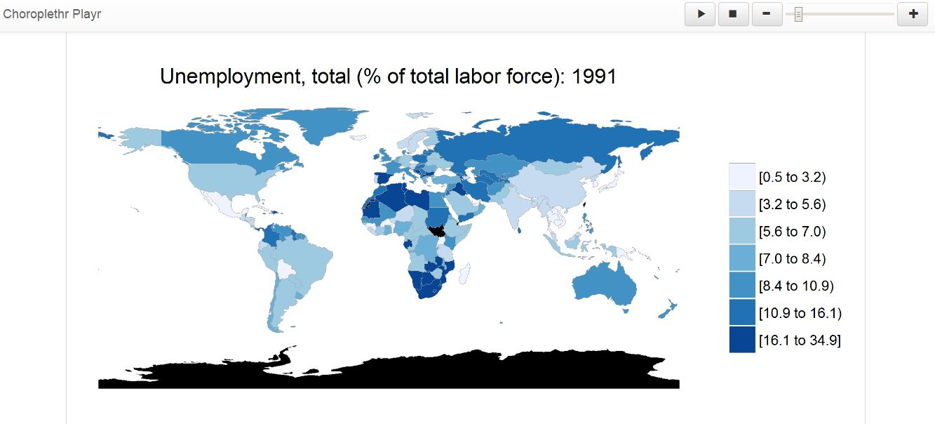
…Animated map in html player

Slide 6
Eg.2 : Interactive map : html
Input : shapefiles (polygon, line, point)
Data source : City of Vancouver
R packages : leaflet, raster
Output : Interactive web map - manual zoom and pan
radio buttons to toggle between base maps
check boxes to switch layers on/off
metadata popup on mouse click / hover
webmap

Slide 7
Interactive map : html

Slide 8
Eg.3 : Interactive map : ‘shiny’ server
Input : shapefile – flood events (1900 to 1997), province boundaries
Data source : Geogratis, Canada
R packages : shiny, leaflet, rsconnect, rgdal
Output : Interactive web map deployed on ‘shiny’ server
Slider bar to choose year(s) of event
drop down list of color palette
metadata popup on mouse click
automated zoom and pan
https://jaya.shinyapps.io/flood/

Slide 9
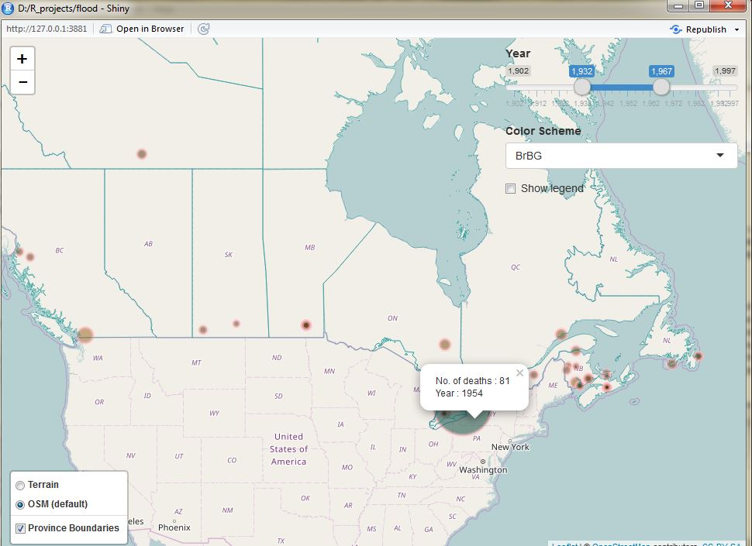

Slide 10
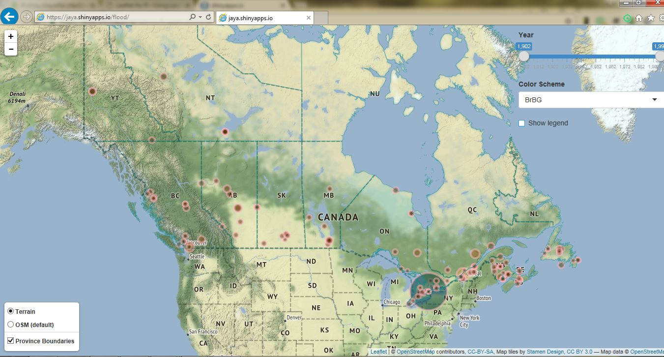

Slide 11
Eg.4 : Land cover classification
Input : Landsat 30m resolution satellite image from 2015
Data source : US Geological Survey
R packages : raster
Processing
Stack 7 Landsat bands
Clip to study area
Plot false color composite
Perform unsupervised classification
Output : classified tif image

Slide 12
Input Landsat 8, 2015 satellite image False color composite – (NIR, Red, Green)
Classified output : 5 clusters
Green : Dense vegetation
Brown : Built-up (residential)
Yellow: Built-up (commercial)
Purple: Sparse veg (mixed class)
Blue : Water
Caveats
Downtown : shadows of tall buildings
Mixing of classes

Slide 13
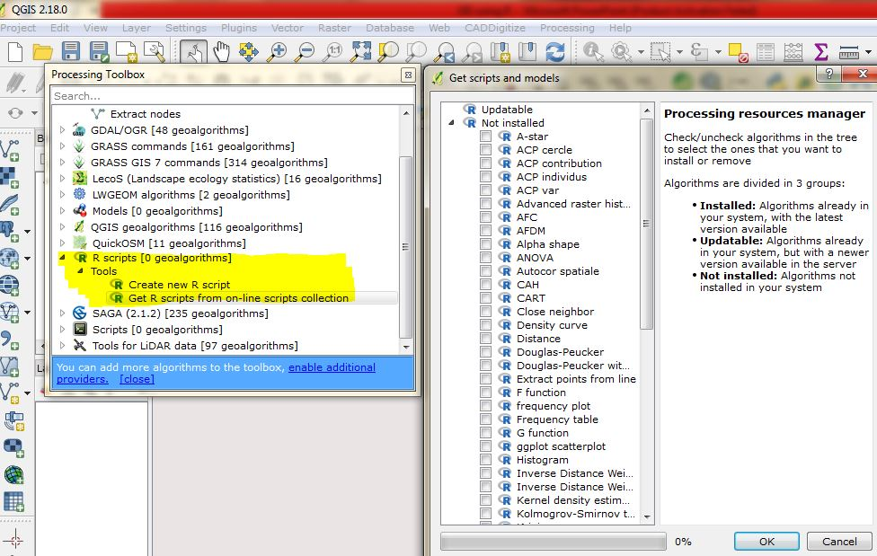
Eg.5 : Using R within QGIS
Several statistical R scripts to choose from in QGIS
Option to create scripts

Slide 14
Using R within QGIS
Input : LiDAR tile from 2013 (cluster of trees)
Data source : City of Vancouver
R packages : rLiDAR, rgl
Processing
reading LiDAR tile
plotting in 3D
Output : png image

Slide 15
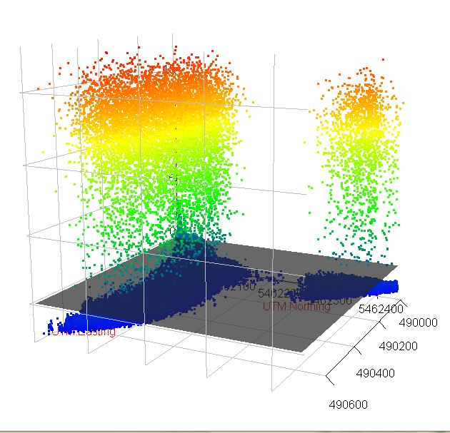
LiDAR plot of trees

Slide 16
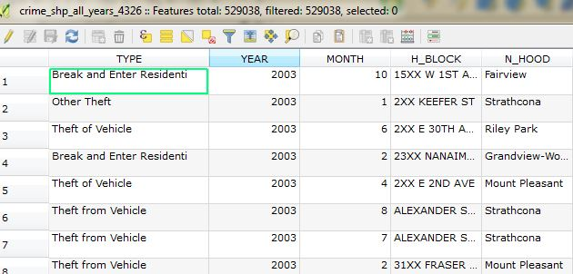
Eg.6 : Crime data analysis
Input : Crime data, (2003-2016)
Data source : City of Van
No. of points : 529,038
R packages : sp, spatstat, rgdal

Slide 17
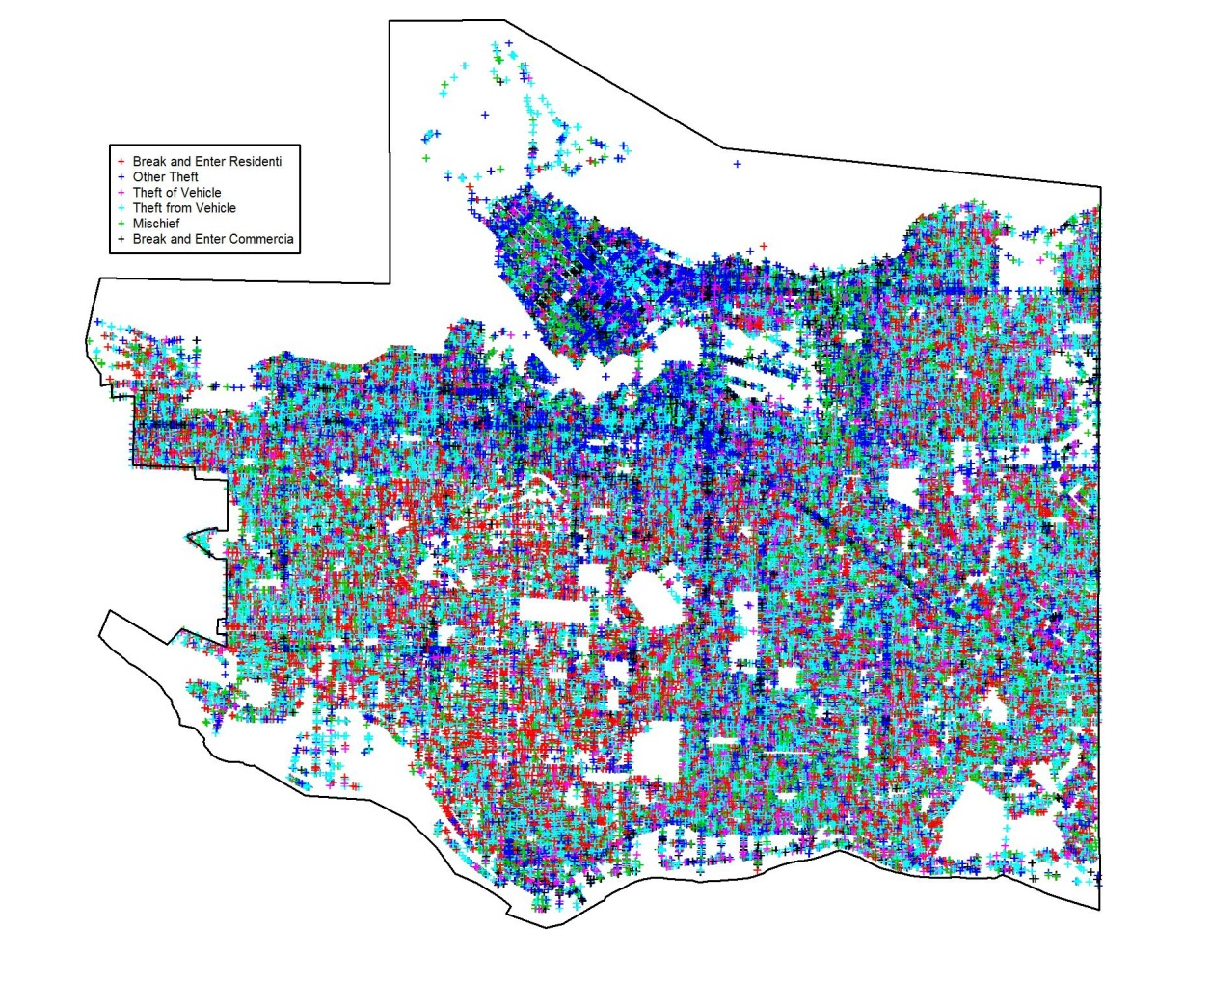
… Crime data analysis
Plot : entire data

Slide 18
… Crime data analysis
Plot : subset - Break and Entry Residential

Slide 19
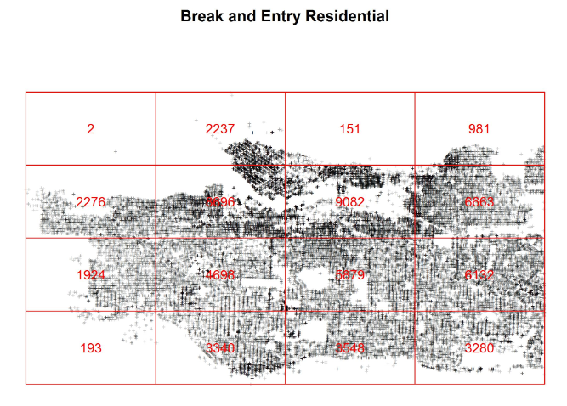
… Crime data analysis
Quadrat Counting

Slide 20
… Crime data analysis
Kernel Density – indicator of point density

Slide 21
… Crime data analysis

Slide 22
Thank you
Jaya Krishnan
jayaakrish@gmail.com

